Slide 1
Project Task Management on Microsoft 365
Presented by
Jonathan Weisglass
BrightWork

Slide 2
Project Task Management on Microsoft 365
AGENDA:
Overview of BrightWork 365 on Microsoft 365
Task Management – The Basics
Building Your Task List & Schedule
Managing the Execution of Your Tasks & Schedule
Live Questions & Answers at the end!

Slide 3
QUICK POLL
Are you currently using Microsoft 365 for Project Management?

Slide 4
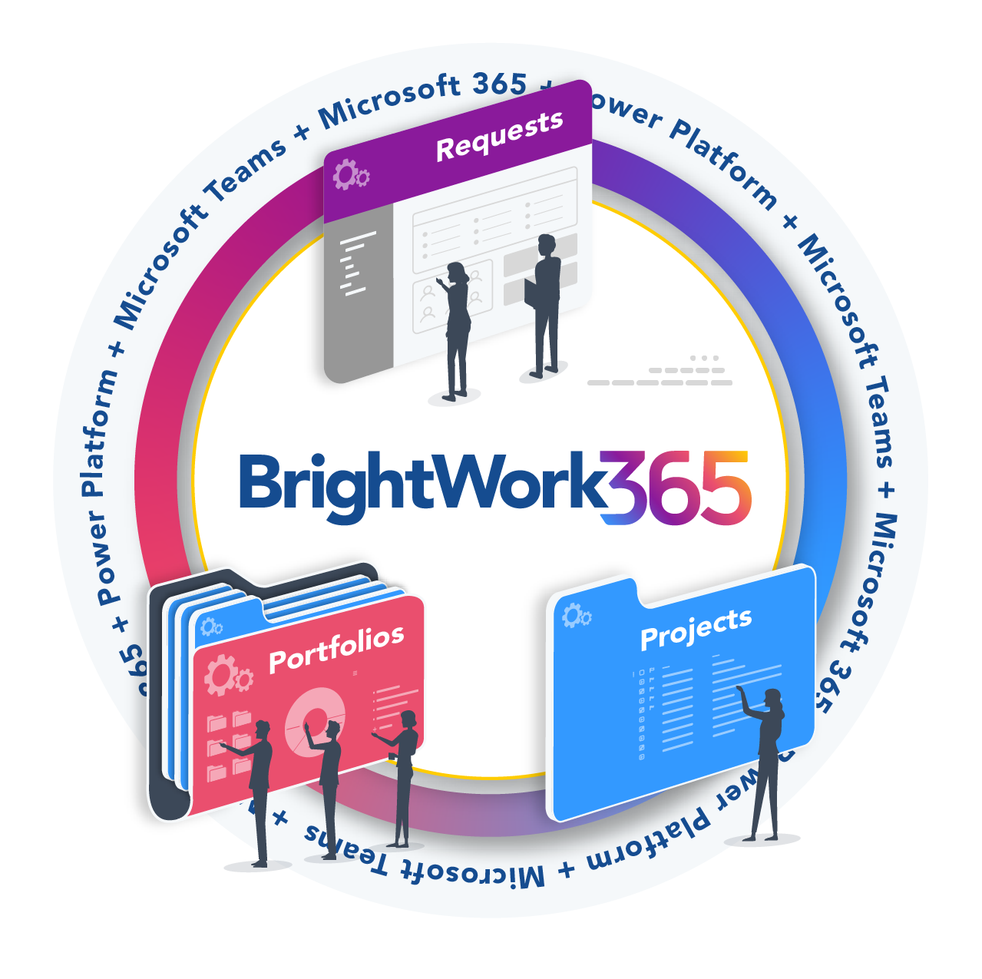
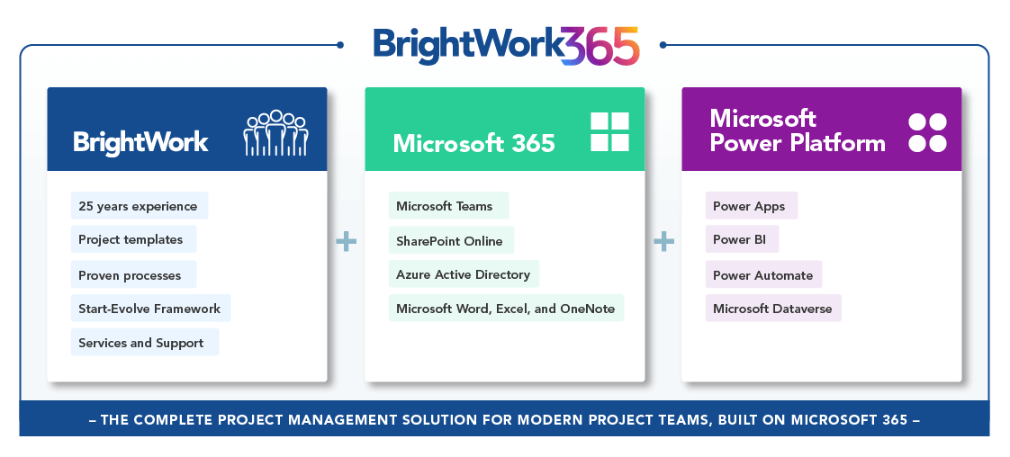
BrightWork 365 for Microsoft 365
The "What"
The “How"
BrightWork 365 Product page
BrightWork 365 Deployment page

Slide 5
More “How"
Built into our Product
with Templates
and
Designed into our Deployment Approach with Services

Slide 6
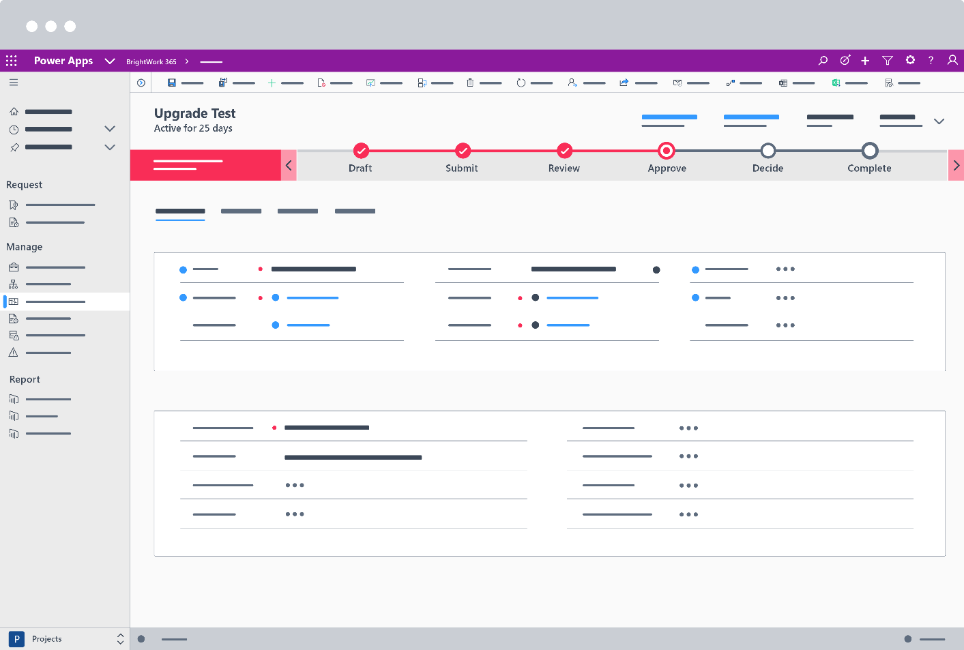

Slide 7
Task Management – The Basics

Slide 8
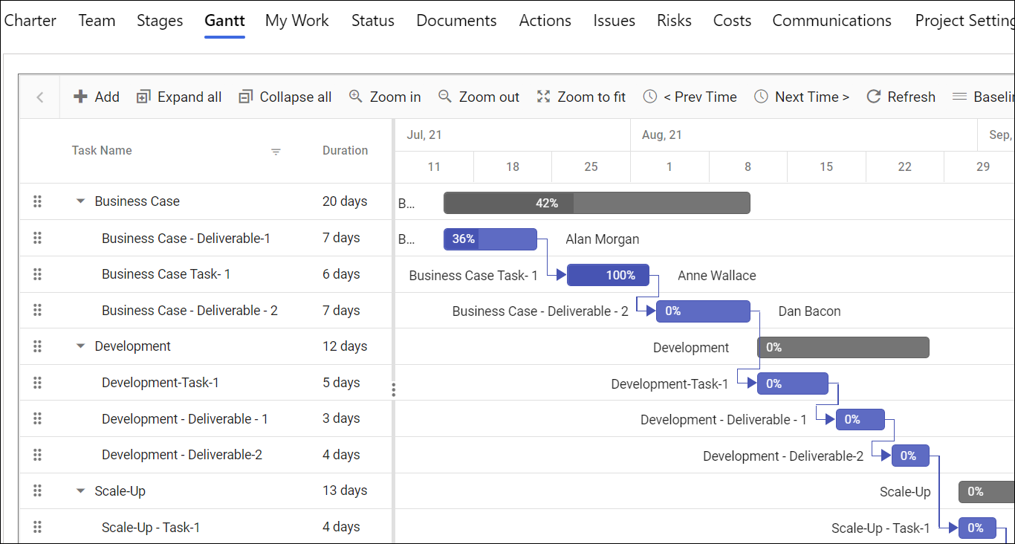
Building Your Task List & Schedule

Slide 9
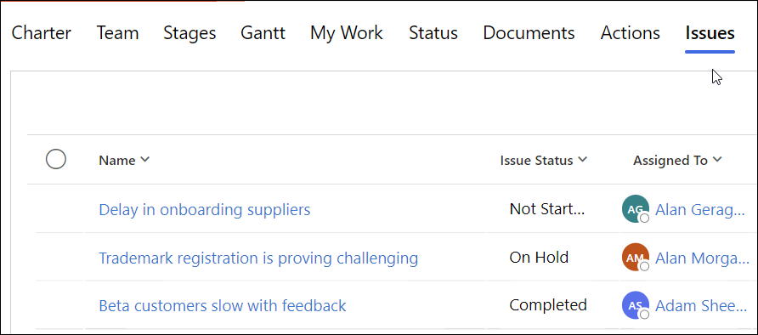
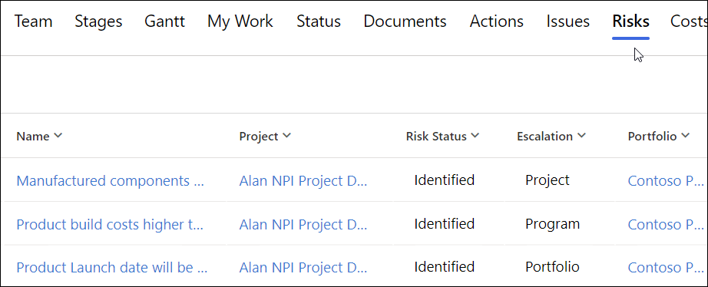
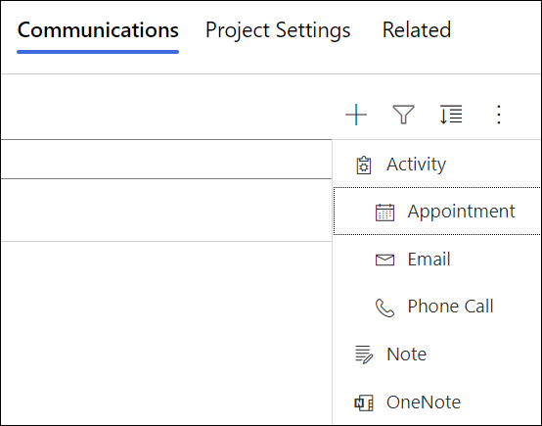
Managing the Execution of Your Tasks & Schedule

Slide 11
THANK YOU
For sales info contact:
Adam Sheehan
Tel: +1 617 631 9825
+353 91 412741
Email: asheehan@brightwork.com

Slide 12
BrightWork 365: Project and Program Management for Microsoft 365
Our mission is to:
Make Project and Portfolio Management with Microsoft SharePoint and Microsoft 365 easier for our customers.

Slide 13
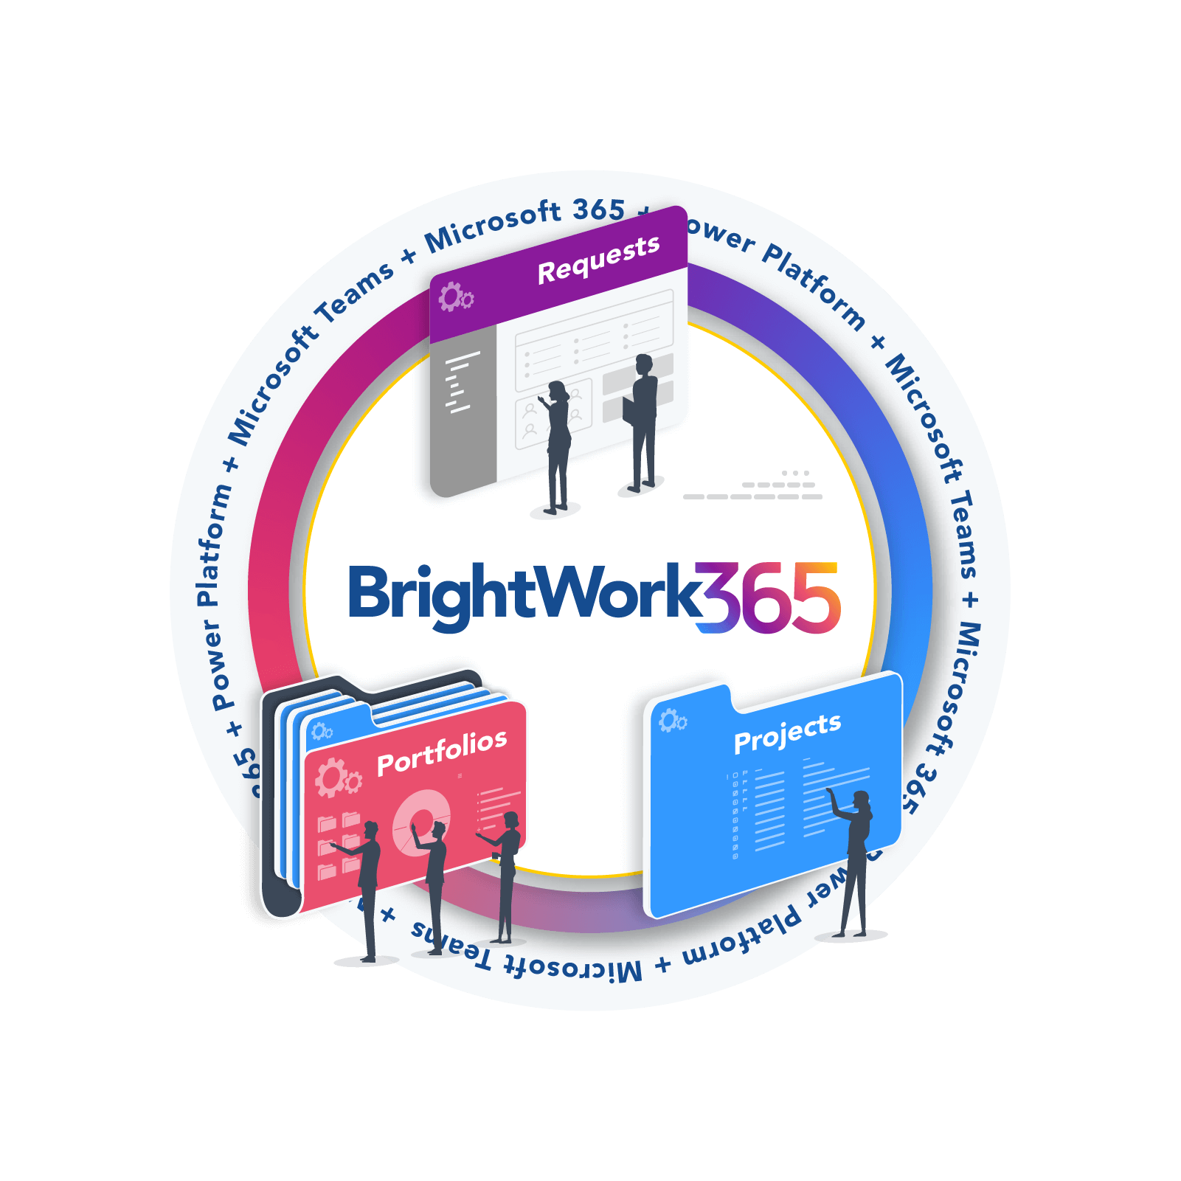
BrightWork 365: Project and Program Management for Microsoft 365
Project Management Success, Made Easy
BrightWork 365 allows organizations to leverage the best of the Microsoft 365 ecosystem for project work and collaboration whilst maintaining a unified view of all projects.
As BrightWork 365 is configurable, organizations can add their processes and ways of working to the Microsoft 365 apps commonly used by their teams.

Slide 14
Introducing BrightWork 365: Project and Portfolio Management for Microsoft 365
Notes:
BrightWork has been around for 25 years. In that time, we’ve partnered with companies of every size in every industry around the world to improve their project and portfolio management processes.
We’ve made some big changes in the last few years – moving to four new releases per year, launching BrightWork Services last year.
Today, I want to share some exciting new changes with you.

Slide 15
Introducing BrightWork 365: Project and Portfolio Management for Microsoft 365
Introducing BrightWork 365 for Microsoft 365
A Project Management Solution built for Microsoft 365.
Process Requests for new Projects
Manage Projects
Control Portfolios and Programs
Uses the best of Microsoft 365 in a fully configurable solution.
Integrates with the Power Platform (Power Apps, Power Automate & Power BI), Microsoft Teams, Azure Active Directory, Word, Excel, OneNote etc. and SharePoint Online
BrightWork 365 Product page
We are happy to assist with your deployment as needed.
BrightWork 365 Deployment page
Notes:
BrightWork has been around for 25 years. In that time, we’ve partnered with companies of every size in every industry around the world to improve their project and portfolio management processes.
We’ve made some big changes in the last few years – moving to four new releases per year, launching BrightWork Services last year.
Today, I want to share some exciting new changes with you.

Slide 16
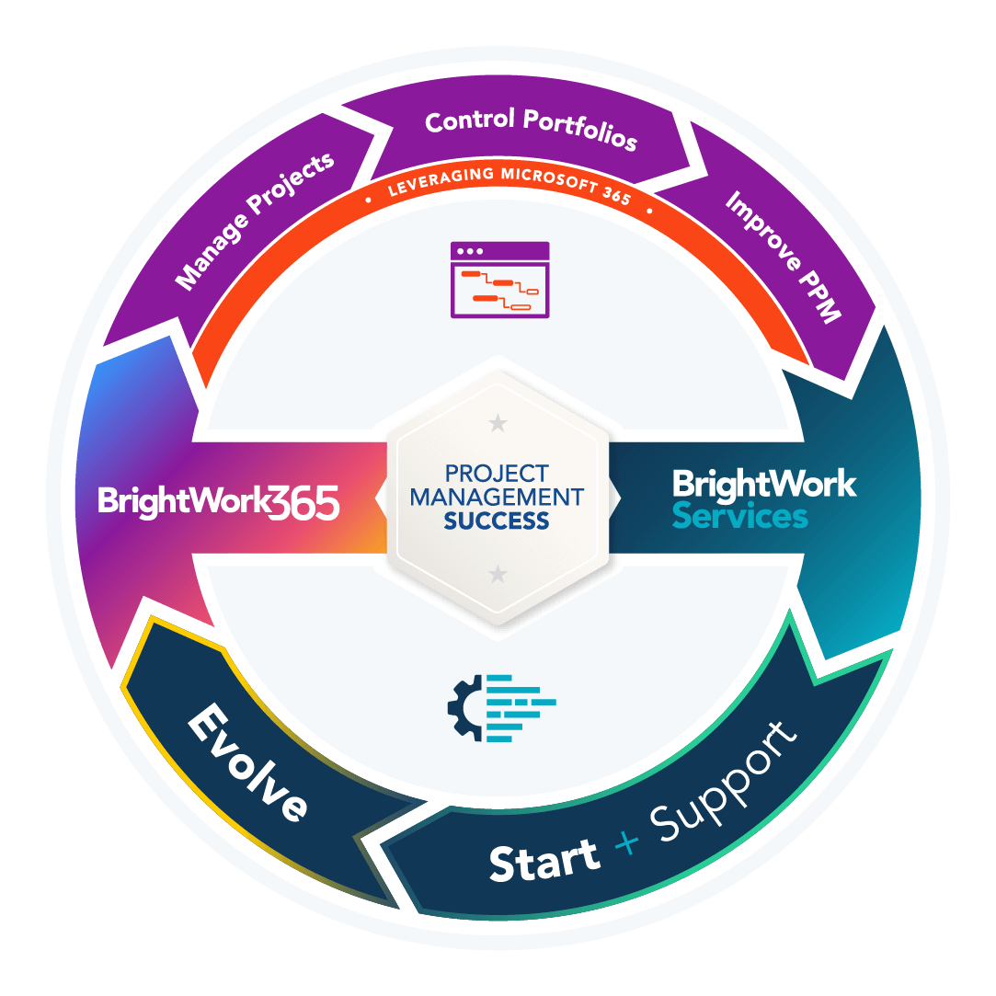
BrightWork 365: Project and Program Management for Microsoft 365
Upgrading to BrightWork 365
Our approach to upgrading your BrightWork 365 solution includes:
A pre-evaluation of your Microsoft 365 solution to facilitate a smooth upgrade process.
Providing on-hand technical assistance during the upgrade process.
Updating any processes to leverage and new features of the latest release.
A member of our technical team will work with your Microsoft 365 administration team to upgrade your tenant to the latest version of BrightWork 365.
They will confirm the solution upgrade and answer any post-upgrade questions you may have.
Contact Customer Success

Slide 17
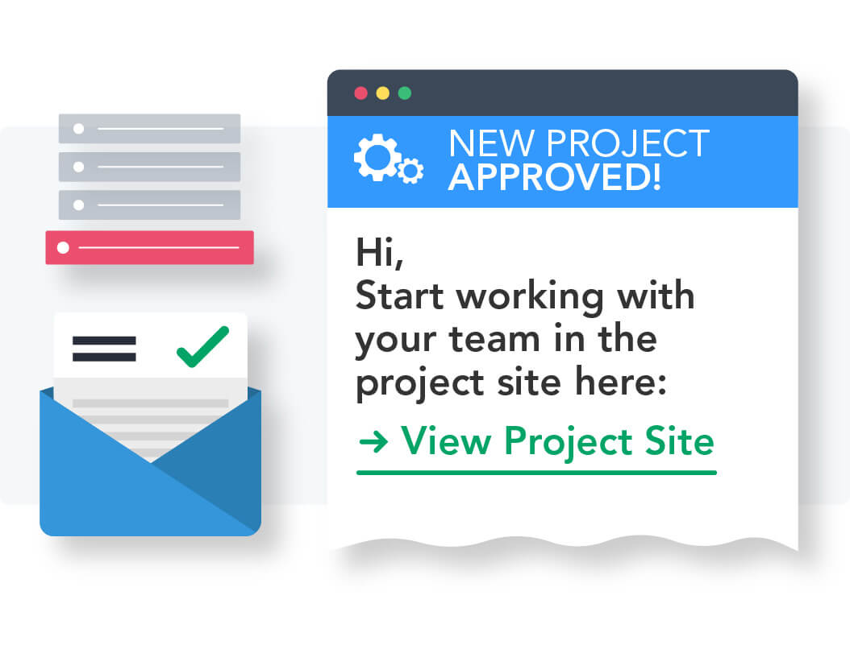
BrightWork 365: Project and Program Management for Microsoft 365
Project Requests
Capture and manage new ideas from anyone in your organization in one solution.
Improve project governance by approving and resourcing the right projects to support strategic goals.
Get visibility into the project pipeline to inform business planning.
Provide clarity about the objectives of the project to help project teams reach their goals.
Streamline the decision process to get a fast start on key projects.

Slide 18
Manage Projects
Save time during project setup with templates and stages.
Streamline project set up by using the Microsoft 365 apps you are familiar with in one app.
Improve project quality with stage gates, providing in-built checks at every project phase.
Save time and reduce errors with automation.
Ensure stakeholder satisfaction with a clear project charter, including acceptance criteria for deliverables.

Slide 19
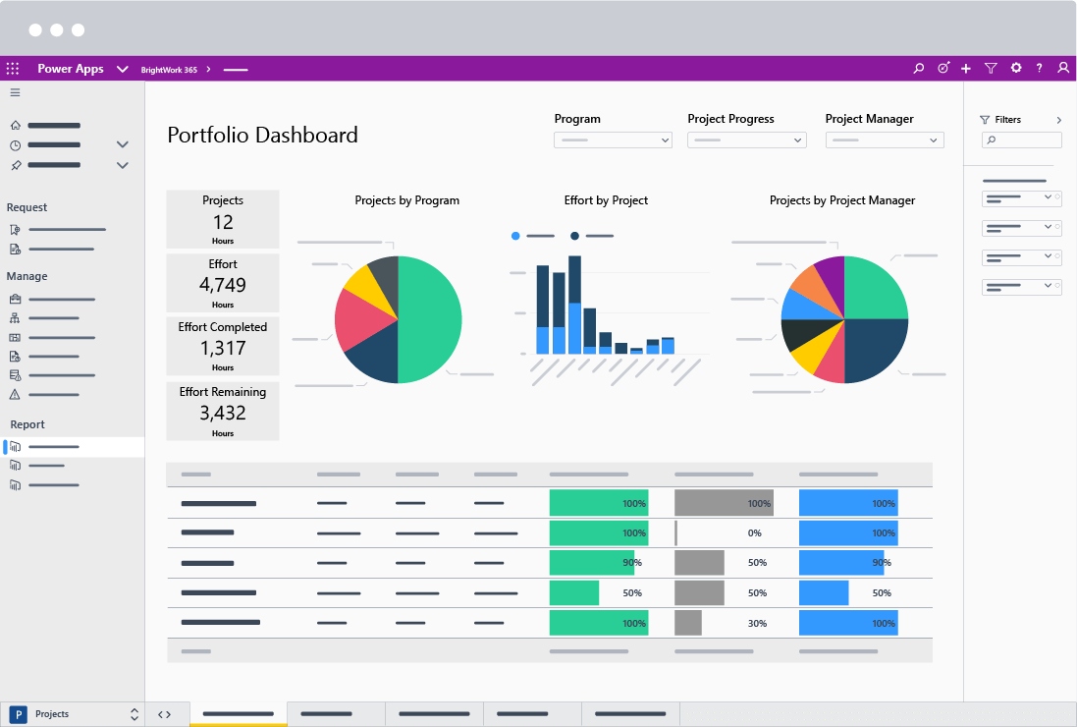
BrightWork 365: Project and Program Management for Microsoft 365
Manage Portfolios
See how portfolios are performing with at-a-glance, real-time reports.
Take action quickly to address issues and keep projects on track.
Visualize project data with interactive reports to understand complex information quickly.
Reclaim lost time with fewer meetings and lengthy email chains.

Slide 20
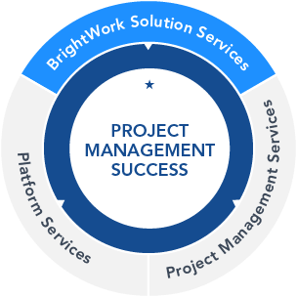
BrightWork 365: Project and Program Management for Microsoft 365
DEPLOYMENT SERVICES
Your dedicated Customer Success Partner is with you at every step.
The BrightWork 365 Start Service is based on our 3D Deployment (Design, Deliver, Deploy) approach.

Slide 21
BrightWork Customer Success stories

